Slide 1
Module 1
Definitions- Robots, Robotics; Types of Robots- Manipulators, Mobile Robots-wheeled & Legged Robots, Aerial Robots; Anatomy of a robotic manipulator-links, joints, actuators, sensors, controller; open kinematic vs closed kinematic chain; degrees of freedom; Robot considerations for an application- number of axes, work volume, capacity & speed, stroke &reach, Repeatability, Precision and Accuracy, Operating environment, point to point control or continuous path control.
Robot Applications- medical, mining, space, defence, security, domestic, entertainment, Industrial Applications-Material handling, welding, Spray painting, Machining.

Slide 2
Origin of Robots
The term Robot has come from the Czech word ROBOTA, which means forced or slave laborer.
The term robot was first introduced in 1921 by Karel Capek in a Czech drama named “Rossum Universal Robots”. According to the drama robot is a machine looking like a human.
During 1940s Asimov in his science fiction stories envisioned Robot as a helper of mankind and postulated 3 basic rules for Robots. These are generally known as the Laws of Robotics.

Slide 3
Laws of Robotics
A robot may not injure a human being or, through inaction, allow a human being to come to harm.
A robot must always obey human beings except unless that is in conflict with the First Law.
A robot must protect its own existence as long as such protection does not conflict with the First or Second Laws
A fourth law was later introduced
A robot may take a human beings job but it may not leave that person jobless.

Slide 4
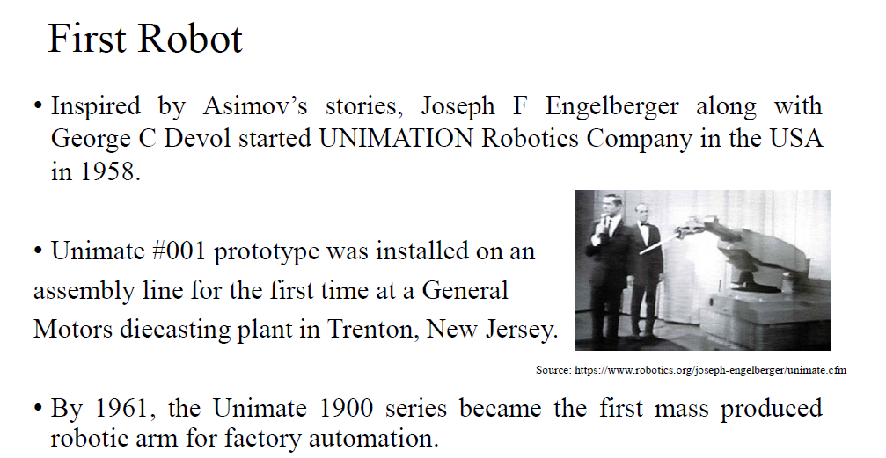

Slide 5
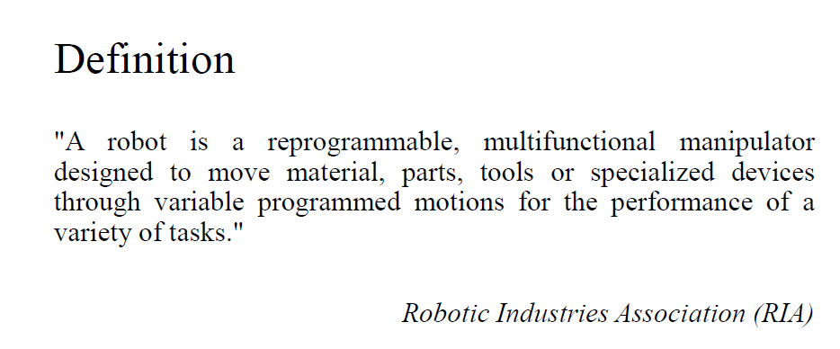

Slide 6
Definitions- Robots
According to Oxford English Dictionary A Machine capable of carrying out a complex series of actions automatically especially one programmable by a computer.
According to ISO: An automatically controlled, reprogrammable, multipurpose manipulator programmable in 3 or more axis, which can either be fixed in place or mobile for use in industrial automation application.
Robots may be constructed on the lines of human form, but most robots are machines designed to perform a task with no regard to their aesthetics.
A robot is a machine designed to execute one or more tasks automatically with speed and precision.

Slide 7
Definitions: Robotics
Robotics: technology dealing with the design, construction, and operation of Robots in Automation
In 1942 the term robotics was used by Isaac Asimov in his story named Runaround.

Slide 8
Scope of Automation and Robotics
To cope with the increasing demands of the dynamic and competitive market modern manufacturing methods should satisfy the following requirements:
Reduce production cost
Increased productivity
Improved product quality
Automation can help to fulfill the above requirement
Automation: Either Hard or flexible automation
Robotics is a example of flexible automation

Slide 9
History of Robotics
Year | Development
1954 | First patent on manipulators by George Devol, the father of robot
1956 | Joseph Engelberger started the first robotics company: Unimation
1962 | General Motors used the manipulator: Unimation in die casting application
1967 | General Electrical Corporation made a 4 legged vehicle
1969-2012 | Various robots were build for space explorations by USA and USSR (Spirit, Opportunity, Curiosity) Many other types of robots were developed by various research organizations with varying moving and thinking abilities
2000 | Asimo humanoid robot was developed by Honda
2015 | Sophia (humanoid) was build by Hanson robotics Hong Kong

Slide 10
Types of robots
Based on Function
Manipulators ,Mobile Robots, Swimming Robots ,Arial or flying Robots
Based on Size
Micro Robots, Macro Robots and Nano Robots
Based on Application
Industrial, Entertainment, Medical, Domestic, Service, Defence and space

Slide 11
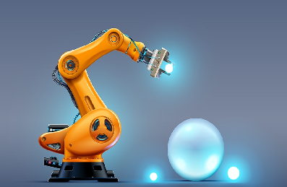
Based on Function: Manipulators
Most commonly used type of robot used in industries are Manipulators . Robotic manipulators are inspired by the human arm kinematics. Manipulator are used to manipulate materials without direct physical contact by the operator. In more recent developments they have been used in diverse range of applications including welding automation, robotic surgery and in space.

Slide 12
Mobile Robots
Mobile Robots: A mobile robot is a machine controlled by software that use sensors and other technology to identify its surroundings and move around its environment. There are 2 types of mobile robots.
Wheeled Robots
Legged Robots

Slide 13

Mobile Robots
Wheeled robots: Wheeled robots are robots that navigate around the ground using motorized wheels to propel themselves. Most wheeled robots use differential steering, which uses separately driven wheels for movement. They can change direction by rotating each wheel at a different speed. There may be additional wheels that are not driven by a motor these extra wheels help keep it balanced.

Slide 14
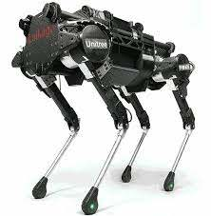
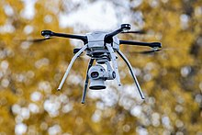
Mobile Robots
Legged robots: are a type of mobile robot, which use articulated limbs, such as leg mechanisms, to provide locomotion. They are more versatile than wheeled robots and can traverse many different terrains, though these advantages require increased complexity and power consumption. Legged robots often imitate legged animals, such as humans or insects.

Slide 15
Under water or swimming Robots

Slide 16
Arial Robots or Flying Robots
An unmanned aerial vehicle (UAV) commonly known as a drone is an aircraft without a human pilot on board and a type of unmanned vehicle. Are used in Target and decoy, Combat, Logistics, Research and development, Civil and commercial UAVs – agriculture, aerial photography, data collection

Slide 17
Based on Size

Slide 18
Based on Application

Slide 19
Based on Application

Slide 20
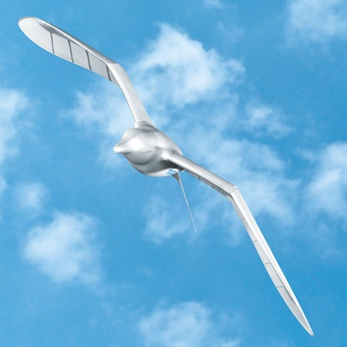
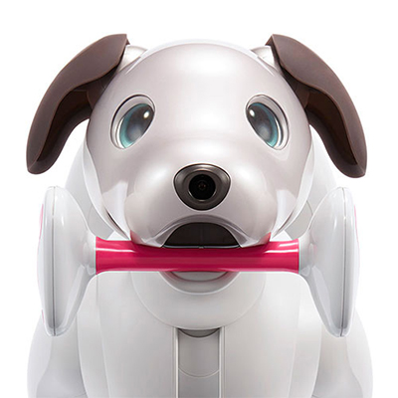
Types of Robots- As per robots.ieee.org
1.Aerospace: It includes all sorts of flying robots—the Smart Bird robotic seagull, but also robots that can operate in space, such as Mars rovers and NASA's Robonaut, the humanoid that flew to the International Space Station
2.Consumer: Consumer robots are robots you can buy and use just for fun, robot dog Aibo, the Roomba vacuum, AI-powered robot assistants, and a growing variety of robotic toys and kits

Slide 21
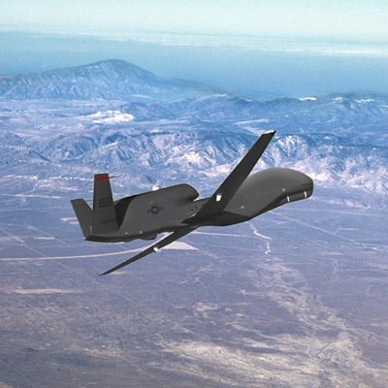
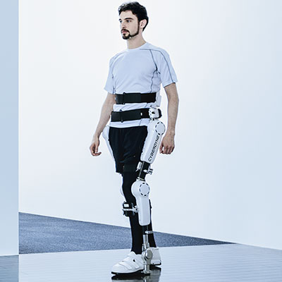
Types of Robots- As per robots.ieee.org
3. Disaster Response: These robots perform dangerous jobs like searching for survivors in the aftermath of an emergency.
4. Drones: Also called unmanned aerial vehicles, drones come in different sizes and have different levels of autonomy.
5. Exoskeletons: Robotic exoskeletons can be used for physical rehabilitation and for enabling a paralyzed patient walk again.

Slide 22
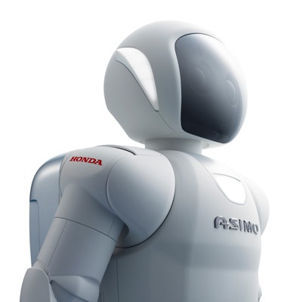
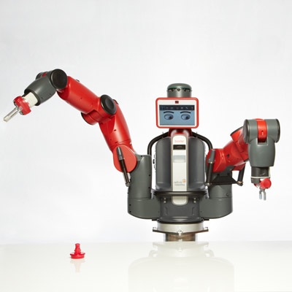
Types of Robots- As per robots.ieee.org
6. Humanoids: This is probably the type of robot that most people think of when they think of a robot. Examples of humanoid robots include Honda’s Asimov
7. Industrial: The traditional industrial robot consists of a manipulator arm designed to perform repetitive tasks.

Slide 23
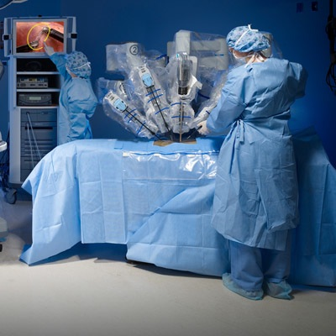
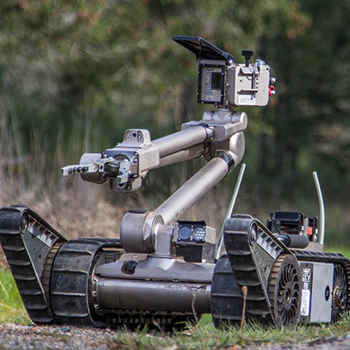
Types of Robots- As per robots.ieee.org
8. Medical: Medical and health-care robots include systems such as the da Vinci surgical robot
9. Military & Security: Military robots include ground systems like Endeavor Robotics' PackBot, used in Iraq and Afghanistan to scout for improvised explosive devices, and BigDog, designed to assist troops in carrying heavy gear.

Slide 24
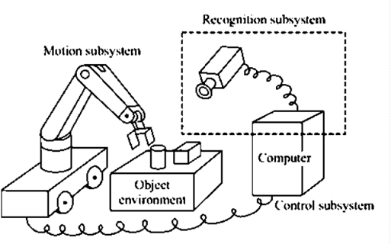
Robotic System Architecture
Motion sub system: It is the physical structure of the robot that carries out desired motion similar to human arms.
Recognition sub system: This subsystem uses various sensors to gather information about the robot itself and any object being acted upon and about the environment. It recognizes the robots state, the objects and the environment based on the sensor data.
Control sub system: The control subsystem influences the robots motion to achieve a given task using the information provided by the recognition subsystem.

Slide 25
Motion Subsystem
Manipulator
End-effector
Actuator
Transmission

Slide 26
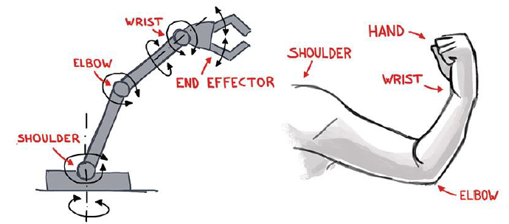
Anatomy of Manipulator
Like human, a robot manipulator also has arm, wrist and hand arrangement.
Arm ensures mobility and reachability.
Wrist confers orientation.
End-effector performs required task.

Slide 27
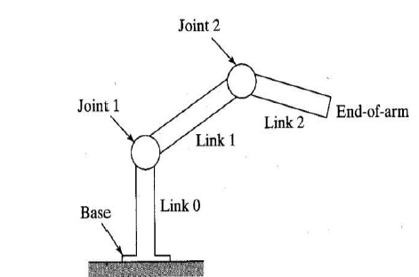
Manipulator
Physical structure that moves around.
It comprises of rigid bodies called links, connected by means of joints

Slide 28
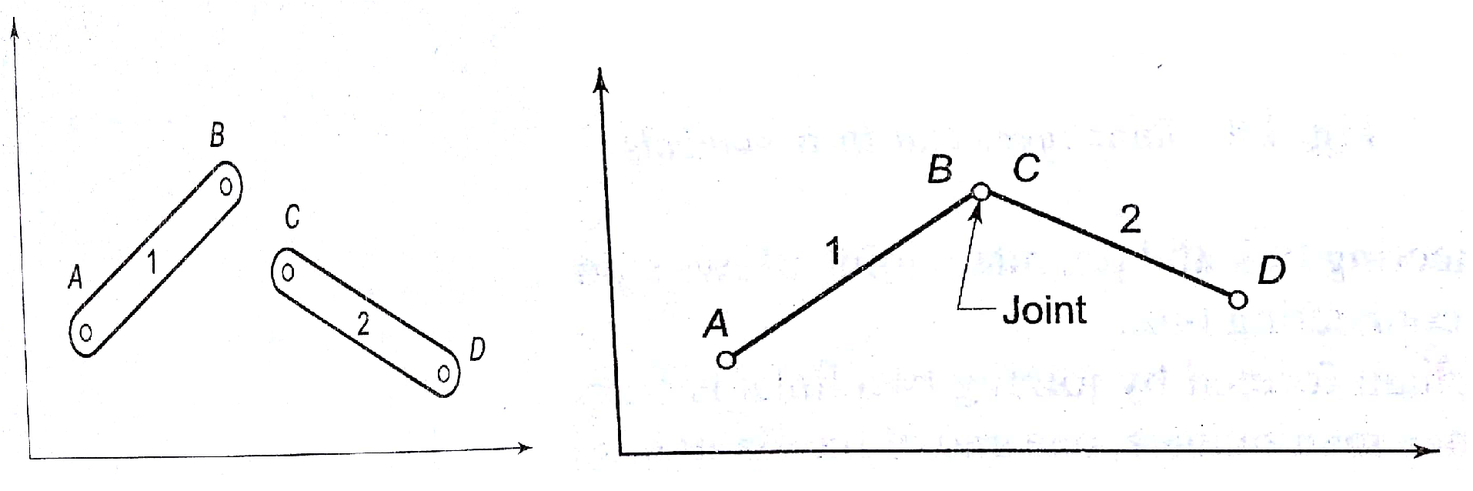
Links
The mechanical structure of robotic manipulators are rigid links or bars
A rigid link that can be connected, at most with two other links are referred to as binary links.
Two links are connected together by a joint.

Slide 29
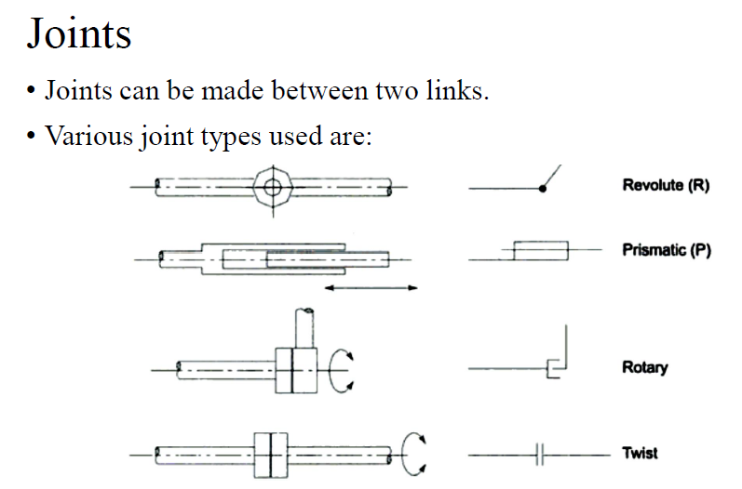

Slide 30
Revolute joints
The two links are joined by a pin (pivot) about the axis of which the links can rotate with respect to each other
https://www.youtube.com/watch?v=wwyJS9X3WvE

Slide 31
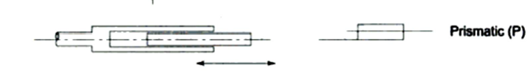
Prismatic joints
Prismatic joint: the two links are so jointed that these can slide (Linearly move) with respect to each other.
https://www.youtube.com/watch?v=ih3oXigeY-U

Slide 32
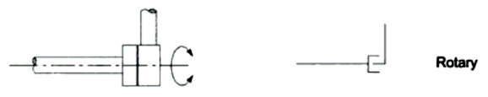
Other commonly used Joints
Cylindrical (Rotary) joint: One link rotate against the other at 90º
https://www.youtube.com/watch?v=OxC9HLuZ0W8
Twist joint: two links remain aligned along a straight line but one turns (twists) about the other along the link axis.

Slide 33
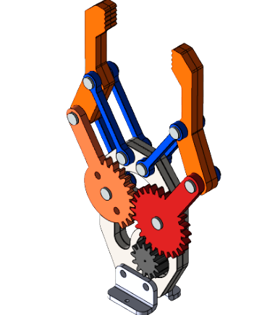
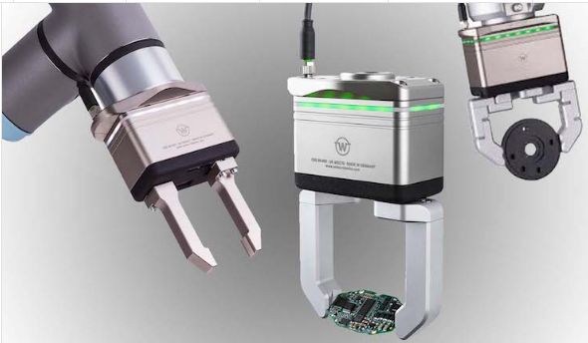
End Effectors
This is the part attached to the end of a robot manipulator. This resembles the human hand.
It’s a mechanical hand that manipulates an object or holds it before they are moved by the robotic arm

Slide 34
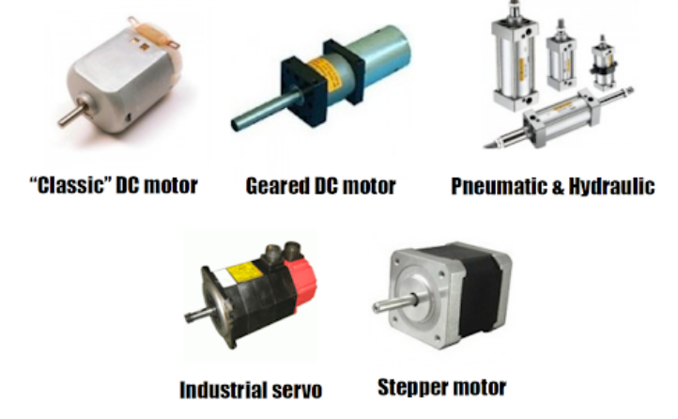
Actuators
The actuators of a robot provides the motion to a manipulator links and the end-effector.
They are classified as pneumatic, hydraulic or electric based on the principle of operation.
Electric motor (ac or dc) when coupled with motion transmission elements like gears, they are together called as actuators

Slide 35
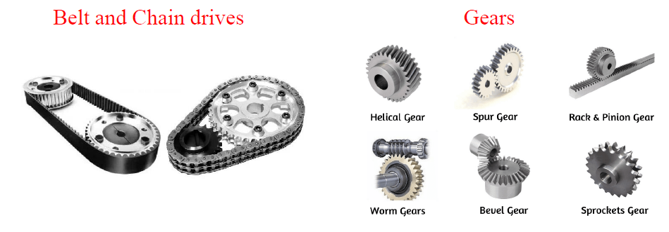
Transmission
These elements transmit motion from the electric motors and pneumatic / hydraulic actuators to the actual links of the manipulator.

Slide 36
Recognition subsystem
The most important element in the recognition subsystem is the sensor and A to D convertor.
Sensors:
Most of the sensors are essentially transduces which convert one form of signal to another.
Inclusion of sensors to a robot changes its dumb nature to an intelligent one.
Sensors fall into many general areas like: Vision, touch, range and proximity detection, navigation, speech recognition.
A to D Convertor:
This device interfaces the sensors with the robots controller.
Converts analog quantity to digital quantity.

Slide 37
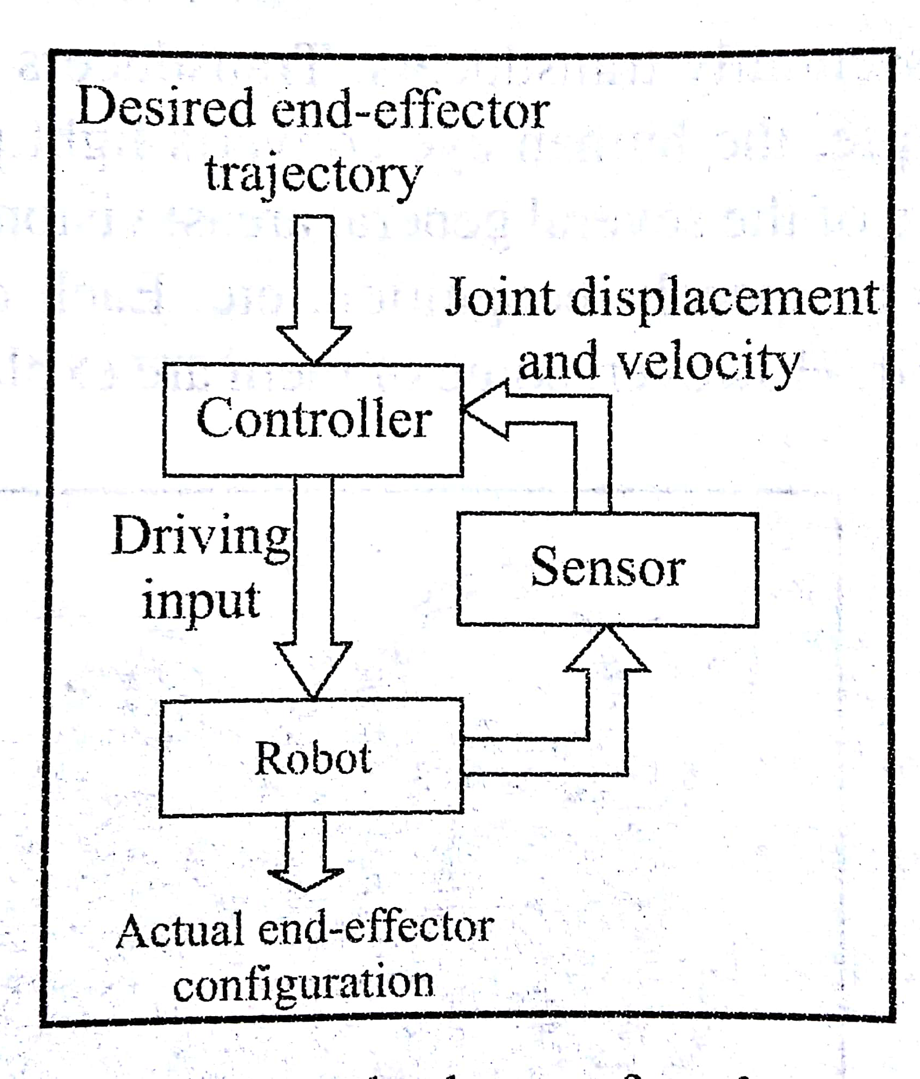
Control Sub system
Controller : It’s a special electronic device that has a CPU, memory and sometimes hard disk to store programmed data. It is used to control the movement of the manipulator and the end effector. It processes the user-programmed commands and sends signals to the actuators through DACs. The programming languages can be BASIC , Fortran, C and C⁺⁺ . However Commercial robots use their domain specific languages.
KUKA Germany uses KRL(KUKA Robot Language)
Fanuc Japan uses Karel robot programming Language.
The digital signals from the controller is converted to analog signals by DAC and is amplified to drive the actuators.

Slide 38
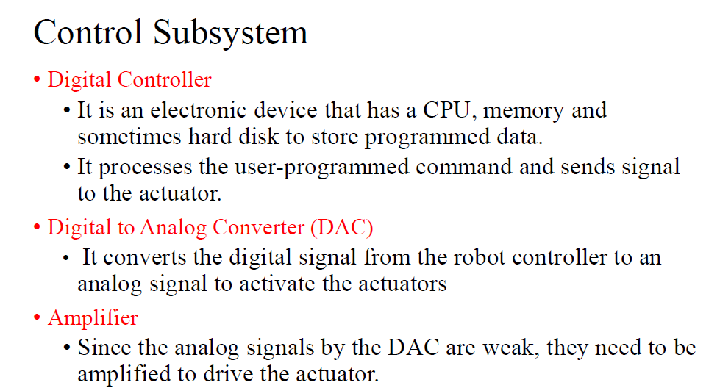

Slide 39
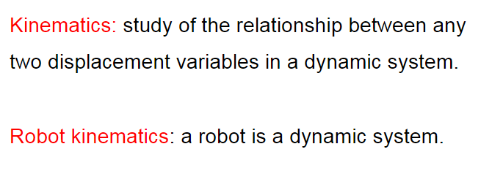
Kinematics

Slide 40
Kinematic Chains
A kinematic chain is a system of rigid bodies which are joined together by kinematic joints to permit the bodies to move relative to one another.
Kinematic chains can be classified as:
Open kinematic chain: There are bodies in the chain with only one associated kinematic joint.
Closed kinematic chain: Each body in the chain has at least two associated kinematic joints. A mechanism is a closed kinematic chain with one of the bodies fixed (designated as the base).

Slide 41
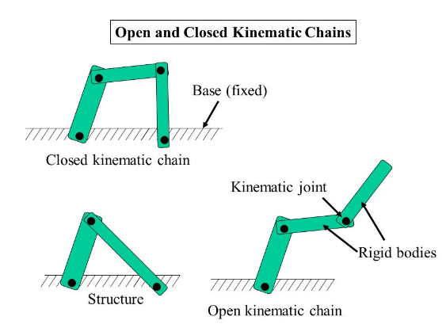
Open Kinematic Vs Closed kinematics chain

Slide 42
Open Kinematic Vs Closed kinematics chain
Open Kinematics | Closed kinematics
An open kinematic chain consists of a series of rigid bodies (links) connected by joints, where the terminal link is free to move in space. | A closed kinematic chain is a mechanical system where the terminal link is fixed or constrained relative to another link.
Each link of the chain is connected to only one or two neighboring links via joints. | The last link (end-effector) is connected to another body or frame, creating a loop or a closed structure.
The end-effector (the last link) is not fixed to any other body and is free to move independently in space. | Movement at one joint affects the position and orientation of subsequent joints due to the interconnected nature of the chain.
Common in robotics for tasks requiring precise positioning (e.g., robot arms). | Prevalent in applications where stability and force transmission are crucial (e.g., leg mechanisms in walking robots).

Slide 43
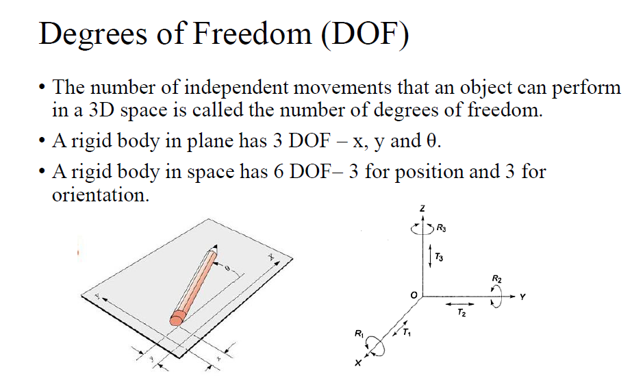

Slide 44
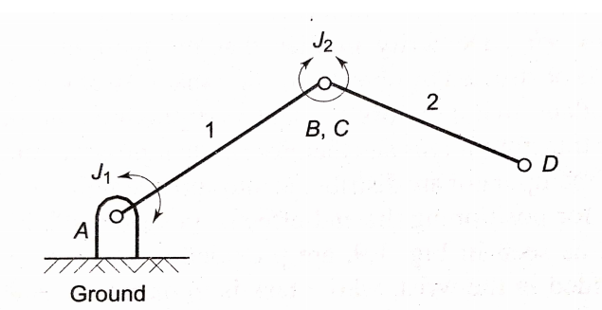
Note:
An open Kinematic chain with one end connected to the ground by a joint and the farther end of the last link free has as many DOF as the number of joints or links in the chain.

Slide 45
Arm Configuration
The DOF of a manipulator is distributed into two sub assemblies
Arm –positioning the end-effector.(3 DOF)
Wrist –orienting the end-effector.(3 DOF)
The purpose of the arm is to position the wrist in the 3D space.
The mechanics of the arm with 3 DOF depends on the types of 3 joints employed and their arrangement.
According to the joint movements(prismatic or rotary joints) and arrangement of links, 4 well distinguished basic structural configurations are possible for the Arm. They are:
Cartesian or Rectangular-(all 3 P joints)
Cylindrical-(one R and two P joints)
Polar or Spherical-(two R and one P joints)
Articulated(Revolute or Joined ARM)- (all 3 R joints)

Slide 46
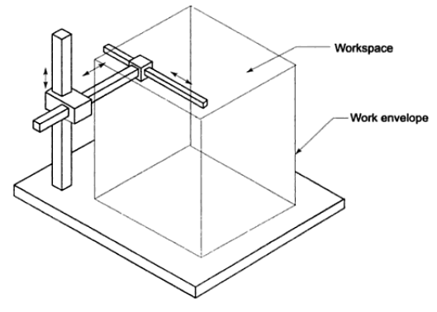
Cartesian or Rectangular configuration
Simplest configuration with all 3 prismatic joints.
It is constructed by 3 perpendicular slides, giving only linear motions along three principal axes.
There is an upper and lower limit for the movement of each link.
The Endpoint of the Arm is capable of operating in a cuboidal space called Workspace
Workspace represents the portion of the space around the base of the manipulator that can be accessed by the arm endpoint. The volume of the space swept is the work volume and the surface of the workspace describes work envelope.
https://www.youtube.com/watch?v=ci_mpRERMog

Slide 47
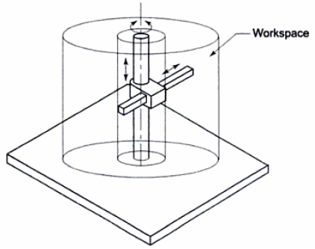
Cylindrical Configuration
One revolute and two prismatic joints
RPP configuration
The rotary joint may have either a column or a block revolving around a stationary vertical cylindrical column.
The vertical column carries a slide that can be moved up and down along the column. The horizontal link is attached to the slide such that it can move linearly in and out with respect to the column.
Workspace is cylinder.
https://www.youtube.com/watch?v=Hj7PxjeH5y0

Slide 48
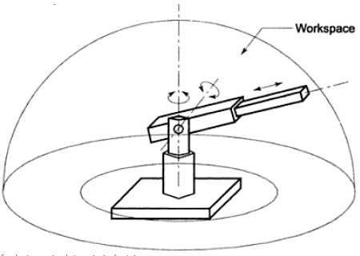
Polar (Spherical) Configuration
One prismatic and two revolute joints.
RRP configuration.
Workspace is partial spherical.
It consists of a telescopic link that can be raised or lowered about a horizontal revolute joint. These 2 links are mounted on a rotating base.
https://www.youtube.com/watch?v=B_Er7rhZMqM

Slide 49
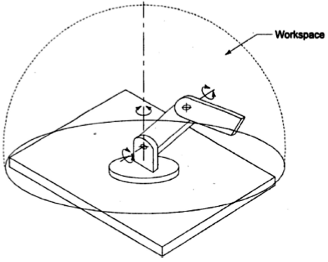
Articulated(Revolute or Joined) ARM
All three revolute joints.
Best simulates a human arm.
RRR configuration.
Workspace is spherical.
It consists of 2 straight links corresponding to the human forearm and upperarm with 2 rotary joints corresponding to the elbow and shoulder joints. These 2 links are mounted on a vertical rotary table .
https://www.youtube.com/watch?v=n_H8frHgM4o

Slide 50
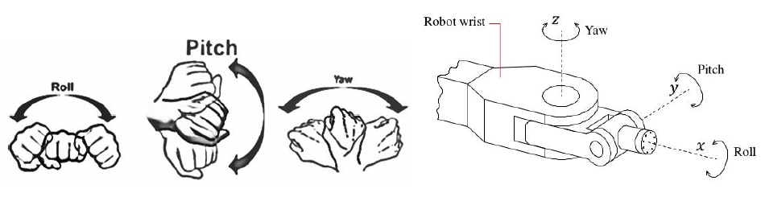
Wrist configuration
The wrist subassembly movements enable the manipulator to orient the end effector to perform the task properly .
Requires only rotary joints since its sole purpose is to orient end effector.
It permits rotation about three perpendicular axis ie.,
Roll (motion in a plane perpendicular to end of the arm)
Pitch (motion in a vertical plane passing through the end arm)
Yaw (motion in a horizontal plane passing through the end arm)

Slide 51
Robot considerations for an application
Number of axes
An axis, in a robotics context, can be interpreted as a degree of freedom (DOF).
If a robot has 3 degrees of freedom it can maneuver the X-Y-Z axes. However, it cannot tilt or turn.
When you increase the number of axes (DOF) on a robot, you can access more space than with a robot that has a lower number of axes.
One way to identify the number of DOF of a robot is to simply count its motors.

Slide 52
Work volume
The work volume (work envelope) of the manipulator is defined as the envelope or space within which the robot can manipulate the end of its wrist.
Work volume is determined by:
The number and types of joints in the manipulator (body-and-arm and wrist),
the ranges of the various joints,
the physical sizes of the links •
The shape of the work volume depends largely on the robot’s configuration

Slide 53
Capacity & Speed
Speed in robotic terms refers to the absolute velocity of the manipulator at its end-of-arm.
Sometimes process itself limits the speed of robots movement, for example the quality of weld may degrade with higher speed of operation.
Each axis moves at a different speed. They are listed as degrees traveled per second.
The load carrying capacity is mainly determined by various factors: robot’s size, type of drive systems,.
Load capacity range from a few grams to tons.
The specification provided by manipulator manufacturer is actually the gross weight capacity that can be put at the robotic wrist.

Slide 54
Stroke & Reach
Reach and stroke of the robot are the measure of the work volume of the robot.
The horizontal reach: it is the maximum radial distance at which the robotic wrist can be positioned away from the vertical axis about which the robot rotates, or the base of the robot.
The horizontal stroke: it is the total radial distance the wrist can move.
There is always a certain minimum distance the robot’s wrist will remain away from the base axis.
The vertical reach: is the maximum vertical distance above the working surface that can be reached by the robot’s wrist.
The vertical stroke: is the total vertical distance that the wrist can move

Slide 55
Stroke & Reach
Thus, the horizontal stroke is always less than equal to the horizontal reach.
For a cylindrical coordinate robot the horizontal reach is the outer cylinder of the workspace

Slide 56
Repeatability, Precision and Accuracy
Repeatability is a measure of the difference in the values between two successive measurements at the same conditions.
The repeatability of a robot might be defined as its ability to achieve repetition of the same task.
Accuracy is a measure of the difference between the measured and actual values.
Accuracy is the difference (i.e. the error) between the requested task and the obtained task (i.e. the task actually achieved by the robot).
Precision is the closeness of agreement between independent measurements of a quality under the same conditions without any reference to the true value.

Slide 57
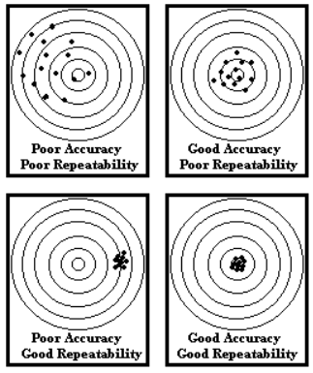
Repeatability is getting the same accuracy and precision every time as long as conditions remains constant.

Slide 58
Point to point control & Continuous path control
Irrespective of the type of joint-space or Cartesian-space motion planning. We have two types of trajectories , point-to-point and continuous
The point-to-point is applicable for pick-and-place operations, whereas the continuous is more applicable for applications like welding, etc.
In the Point-To-Point (PTP) motion of a robot, it has to move from an initial to a final joint configuration in a given time t_{f}. Here, the actual end-effector trajectory is not important. The locations are recorded in the control memory.
The motion-planning algorithm should generate a trajectory which may be capable of optimizing some performance criteria when each joint is moved from one position to another.

Slide 59
Continuous path control
The CP robot is capable of performing movements along the controlled path. With CP from one control, the robot can stop at any specified point along the controlled path.
All the points along the path must be stored explicitly in the robot's control memory. Applications Straight-line motion is the simplest example for this type of robot.
Some continuous-path controlled robots also have the capability to follow a smooth curve path that has been defined by the programmer.

Slide 60
In several applications like welding of two pipes, on the other hand, the path needs to be described in terms of a number of points which are typically greater than two.
A set of intermediate positions are set for lifting off and setting down a work-piece so that reduced velocities are obtained with respect to direct transfer of the object.
For more complex applications, it desirable to specify a series of points so as to guarantee better monitoring of the executed trajectories.
The points need to be specified more densely in those sections of the trajectory where obstacles have to be avoided or a high path curvature is expected.

